Slide 1
TCHR8002 Teaching and Learning: ECE Curriculum studies in Aotearoa New Zealand: Whakaako me te Ako: Te Akoranga Marautanga o te Mātauranga Kōhungahunga I Aotearoa
Session Three: Theories

Slide 2
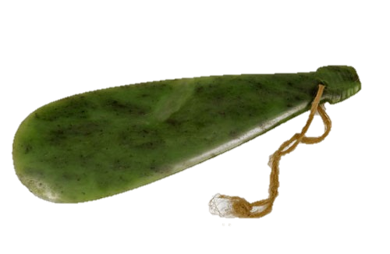

Karakia Timatanga
Kia hora te marino Kia whakapapa pounamu te moana Hei huarahi mā tātou i te rangi nei Aroha atu, aroha mai Haumi e , hui e, Taiki e! | May peace be widespread May the sea be like greenstone A pathway for us all this day Let us show respect For one another Bind us all together!
Notes:
Year One Karakia

Slide 3
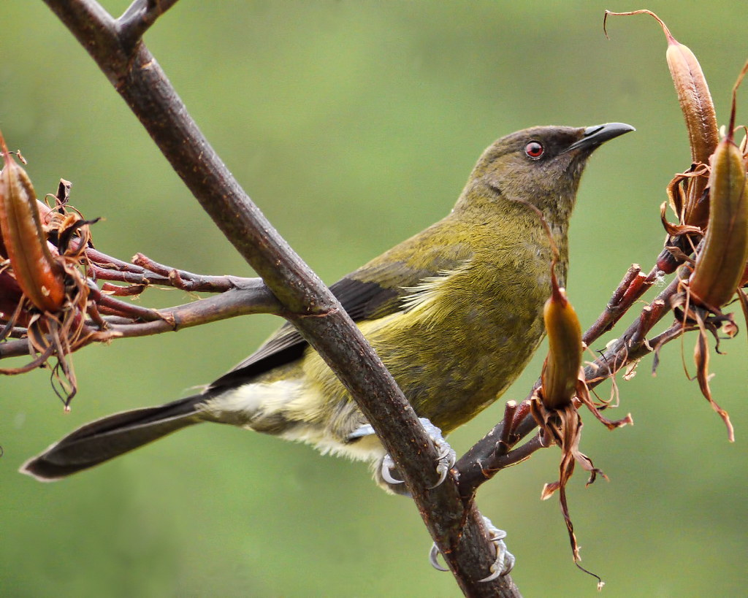
Waiata
Hutia te rito o te harakeke
Kei hea te kōmako e kō
Kī mai ki ahau
He aha te mea nui?
Te mea nui o tēnei ao?
Māku e kī atu ki a koe
He tangata, he tangata!
Remove the heart of the flax, where will the bellbird sing?
If you ask me, what is the greatest thing in the world?
I will reply to you, it is people, it is people!

Slide 4
Kaupapa o te rā
Theories that influence Te Whāriki
Te Whāriki: Early Childhood Curriculum

Slide 5

Whanaungatanga
Mauī / Matau

Slide 6
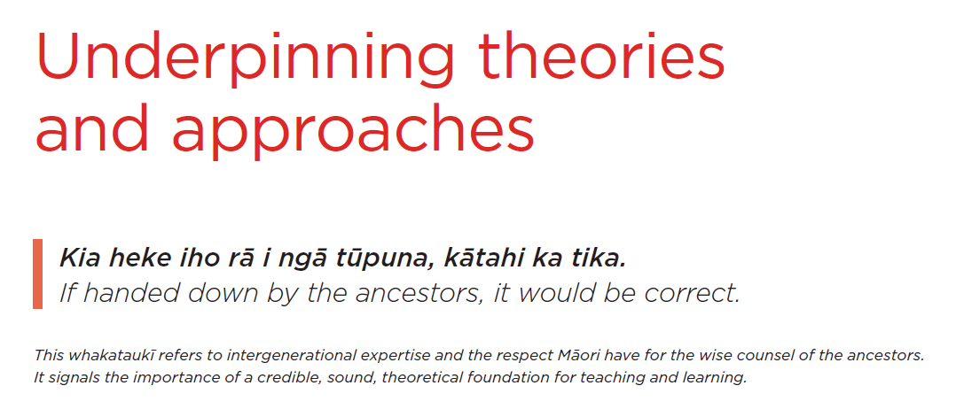

Slide 7
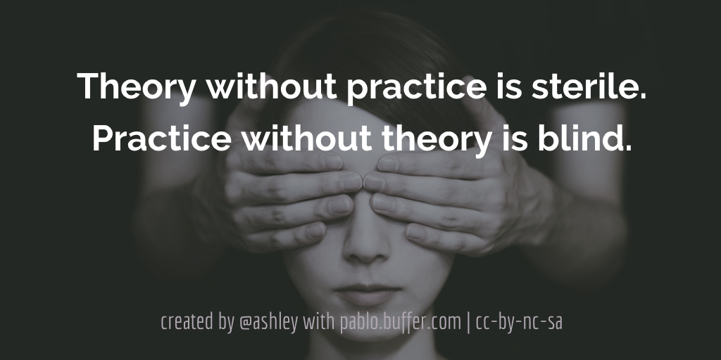
Notes:
Sometimes theory can be viewed as boring or hard to grasp without practical application, however we need to know theory to inform our practice. We will do what we can in class together to find ways to link theory to practice and you will be able to embed your learning while you are out on practicum later in the semester.
Short version, we need theory.

Slide 8
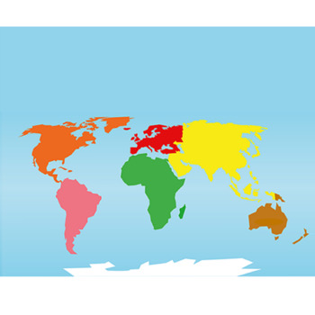
Theory: How’d we get here?
Charles DARWIN
Theory of Evolution 1844
Sigmund FREUD
Theory of Psychoanalysis1890
Carl
JUNG
Analytical Psychology
1913
Abraham MASLOW
Hierarchy of Needs 1943
John BOWLBY
Attachment Theory
1958
Jerome
BRUNER
Scaffolding Theory
1976
Barbara
ROGOFF
Guided Participation
1990
We are here
1840s | 1850s | 1860s | 1870s | 1880s | 1890s | 1900s | 1910s | 1920s | 1930s | 1940s | 1950s | 1960s | 1970s | 1980s | 1990s | 2000s | 2010s | 2020s | 2030s
Lev
VYGOTSKY
Social Constructionist
1968
Urie
BRONFENBRENNER
Ecological Systems
1979
Jean
PIAGET
Universal Principles for Development
1921
Erik
ERIKSON
Psychosocial Development
1950
Albert BANDURA
Social Learning Theory
1977
Notes:
This is just an overall timeline of WESTERN theory to see how it has evolved with reference to humans and education – today we will also look at Kaupapa Māori theories, which should be viewed together with Western theory for the best outcomes for tamariki.

Slide 9
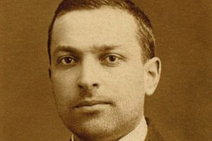
Lev Vygotsky – 1896-1934
Vygotsky’s Social Constructionist theory (1968) was at the forefront of Sociocultural theory, which is fundamental to Te Whāriki (2017).
His theory directly influenced other theorists such as Bruner, Bronfenbrenner and Rogoff.
Focus:
Cognitive Perspective
Cultural-Historical Perspective
Notes:
You might note that Vygotsky’s theory is dated after his death and think it’s a typo. Actually, Vygotsky died at 38 but his theories, although incomplete, continue to be translated from Russian. So while his theory is his work, it was published to the world on his behalf.
Vygotsky is one of the theorists that influenced Te Whāriki’s sociocultural views.
Researching tamariki with a cognitive perspective looks at how thinking, emotion, creativity and the ability to problem solve affect your thinking. Let’s consider each of these ideas for ourselves as learners…..
Cultural-historical perspective looks at what it means for us as learners, learning alongside others around us have. What and who have been our models for learning? So in here, we will have a group of people who may believe the same things, similar things, or entirely different things. These all depend on what and who have been around us so far in life.

Slide 10
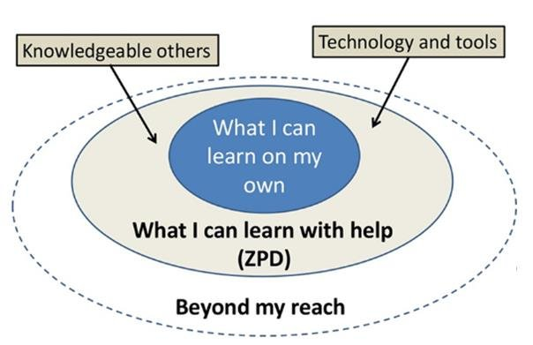
Lev Vygotsky: Zone of Proximal Development
Notes:
Vygotsky formed the first sociocultural theory, other sociocultural theorists borrowed from his ideas.
A Russian psychologist. Vygotsky’s sociocultural theory views human development as a socially mediated process, in which children acquire cultural values, knowledge, beliefs, problem solving through collaboration with more knowledgeable members of society (tuakana-teina)
Dark blue circle can also be an area where a child remains unchallenged or becomes bored – undesirable behaviours can signal that a child is in this space and requires outside assistance to redirect with an interesting challenge.
Light grey is where a teacher, or a more experienced peer (note, this could be a tuakana or teina, dependent on past experiences) can offer assistance that makes something achieveable (this is knowing as scaffolding). An example might be a child learning to swing. You might push a young child on a swing, before teaching them that they can propel themselves using their legs to propel movement. Scaffolding might be a verbal reminder (“kick your legs out!” When the swing is pushed forwards and then “kick your bottom!” when the swing naturally returns). Over time, you might reduce your amount of pushing until one day a child can manage the swing for themselves.
Scaffolding is used to push a child outside of their comfort zone, but also to reduce frustration while they are learning so that they don’t simply give up.
Asking a child to do something that sits in the white outer circle can provide the same frustration as becoming bored and may prevent the child from attempting that learning again if it’s requested of them before they are observed to be ready.

Slide 11
Lev Vygotsky: Learning occurs on two levels
First – Tamariki learn through interaction with others, particularly those more skilled. This is done through socialisation and interacting within their community (interpsychological)
Second – Happens at the individual level, in the child’s mind. The new learning is integrated into the child’s mental structure (intrapsychological)

Slide 12
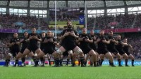
Interpsychological
Notes:
Play with sound on for effect.
Interpsychological through socialisation
Interacting with the community

Slide 13
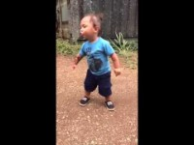
Intrapsychological
Notes:
Intrapsychological – at an individual level

Slide 14
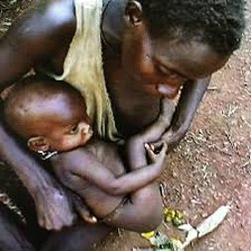
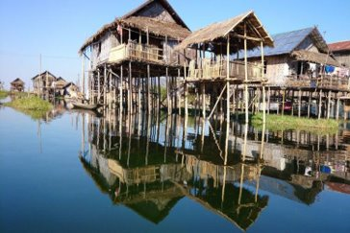
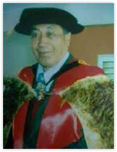
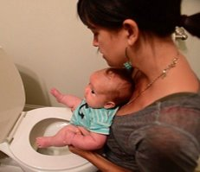
Exploring our world
Toilet training at birth
Typical for African villages, gaining popularity in Western societies
Crawling, walking?
Not until 7 years of age in Ywama Village, Thailand
Hiko Hohepa walked at 6 years of age. (He kōhanga pīpī waiata Composer)
Notes:
Do any of these surprise you? Surprises reveal assumptions

Slide 15
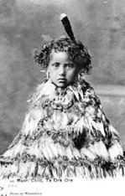
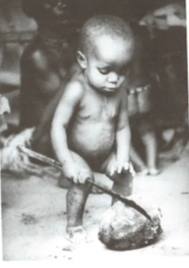
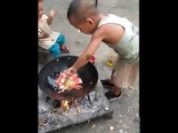
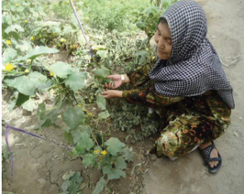
17 month toddler sharpening a machete, Guatemala
4 year old tamariki of chiefs included in important iwi hui. Asking questions, treated as equal in status, New Zealand
14 year old, sole charge of a garden that is responsible for feeding 80 people
China
5 year old cooking a meal and being responsible for young children, Thailand
Notes:
Do any of these surprise you? Surprises reveal assumptions

Slide 16
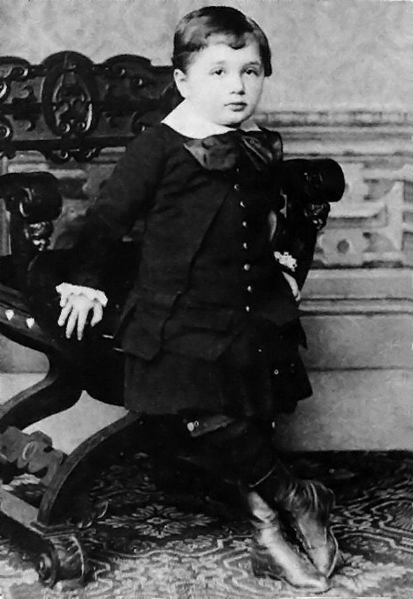
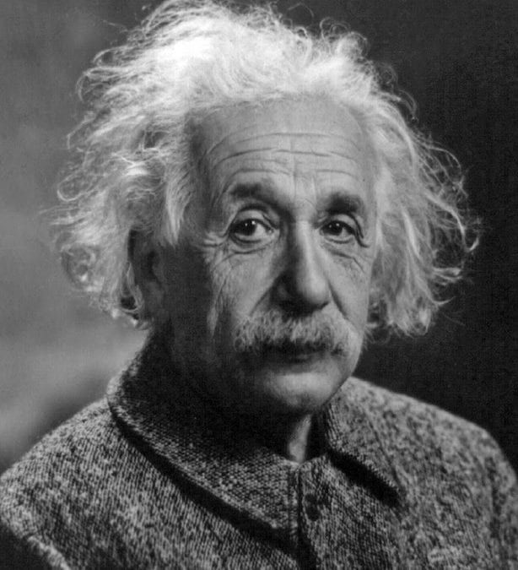
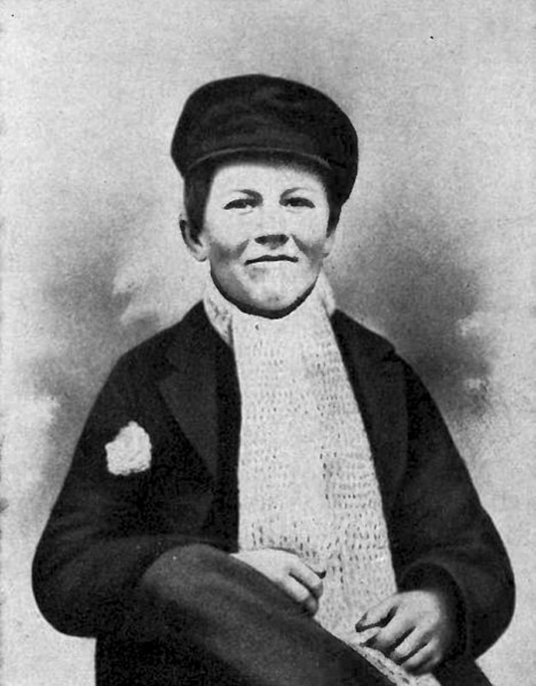
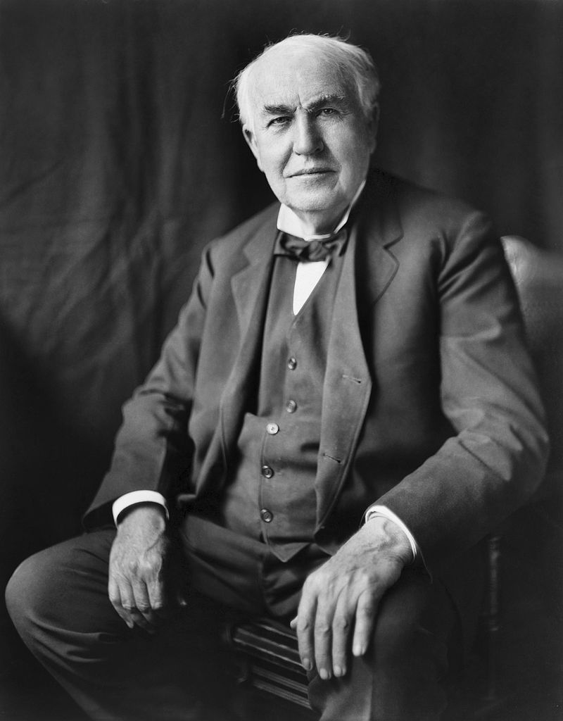
Famous early childhood experiences
Albert Einstein began speaking around 3 or 4 years of age.
Thomas Edison’s mother was told to home-school him as he was “too dull” to succeed academically

Slide 17


Paramanawa

Slide 18
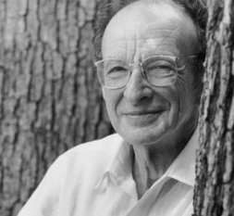
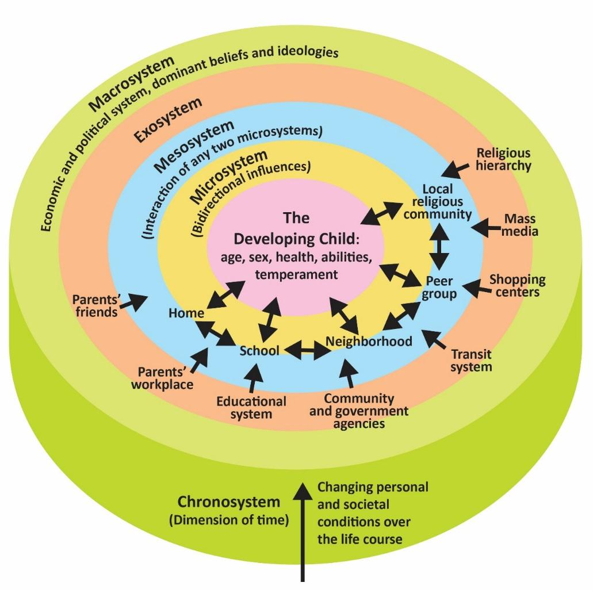
Urie Bronfenbrenner
The Ecological Systems Theory holds that we encounter different environments throughout our lifespan that may influence our behaviour in varying degrees.
These systems include the microsystem, the mesosystem, the exosystem, the macro system, and the chronosystem.​

Slide 19



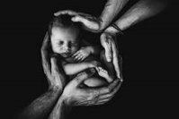
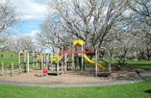

Microsystem
Notes:
The immediate surroundings of the child (people, places and things)
Family, Home, Day care, Teachers, Park, Pets, Kapa haka, Music, Rituals
How might the elements in this system influence this child’s learning? How have (or how do) the elements in your system influence your learning and development?

Slide 20
Mesosystem
Notes:
The mesosystem refers to the relationships between the different elements in the microsystem​
​
Daycare with parents​
Expectations at home vs school​
Family and friends​
Partner and parents​
Language and home language​
​
There is lots of literature that suggests when there is collaboration between the home and the Early childhood centre- this improves the outcome for tamariki. Find a reference in Te Whariki that supports this. Add it to your map.​

Slide 21


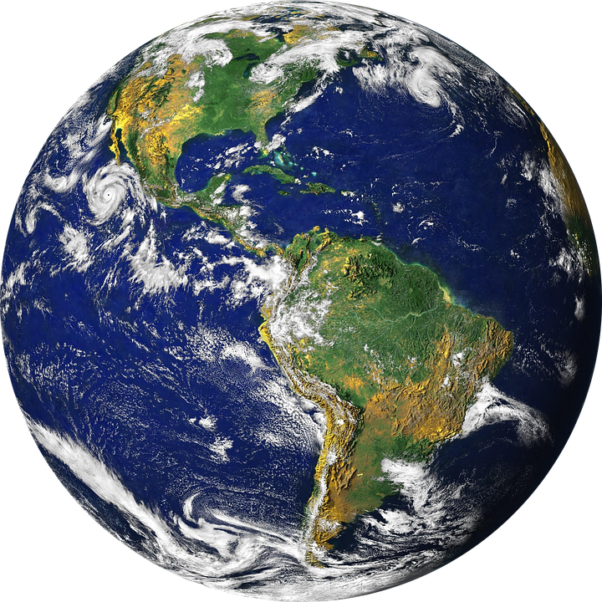
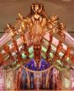

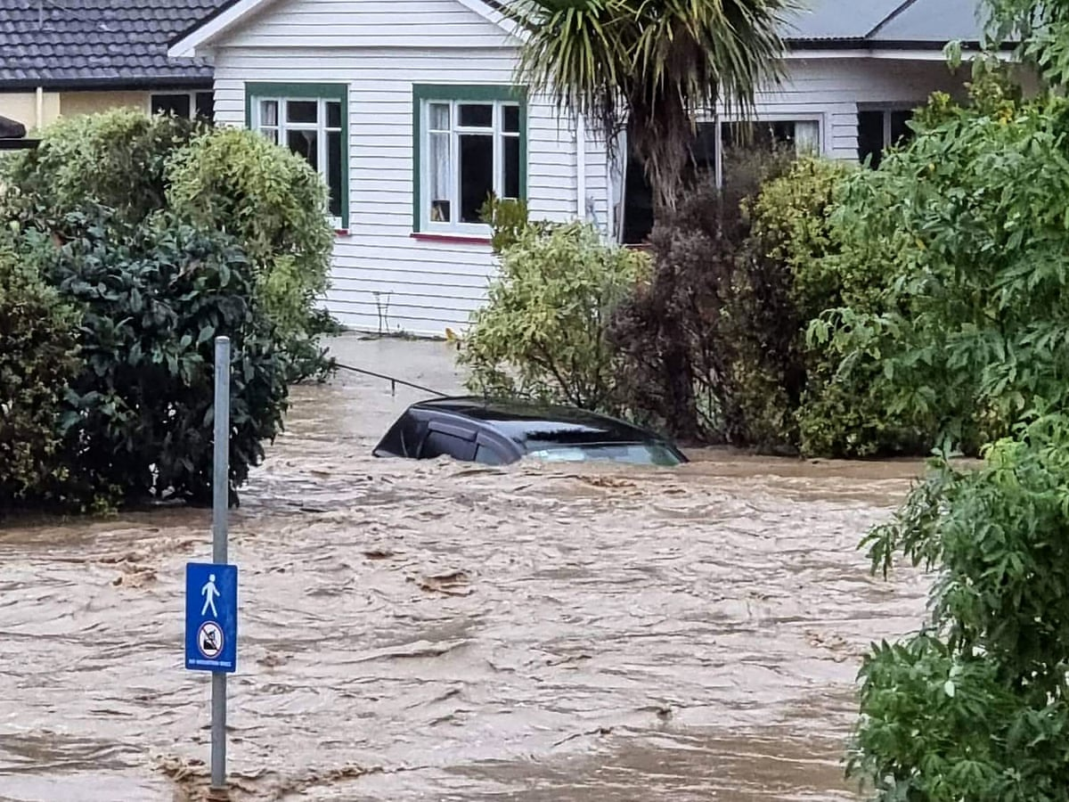
Macrosystem
Notes:
The Macrosystem refers to the culture in which the child lives in
​
-social class​
-political system​
UNCROC​ (United Nations Convention on the Rights of the Child)
World politics​
Climate change​
Technological advancement​

Slide 22
Chronosystem
birth
Back to work
school
Birth of sibling
divorce
New partner
death
Notes:
The chronosystem looks at patterning of time and the transistional events that happen over the life of a child​. Often these are life changing such as
​
Divorce​
Going to school​
A new partner with existing children or a new partner that doesn’t value children
Time that we grow up in​ - consider war in the Ukraine. Consider the COVID epidemic
Women working​ vs staying at home with children
Birth/Death​

Slide 23
Jerome Bruner: Constructivist Approach
Making discoveries rather than being told by a kaiako
Tamariki construct their own knowledge
Tamariki are more likely to remember concepts and knowledge they discover on their own
The role of the kaiako is to facilitate
Spiral curriculum – course of study where students will see the same topic over again increasing in complexity and reinforcing previous learning
Importance of the environment (teachers preparing and making it rich in opportunities to explore)

Slide 24
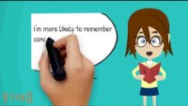

Slide 25
Sociocultural Theories
Sociocultural theory suggests that children learn through social interactions within the culture that they live
Sociocultural theory implies that children’s development is shaped by the people, interactions and environment around them
Often, ideas are shared by a more experienced or skilled peer. Children learn from each other according to these theories

Slide 26
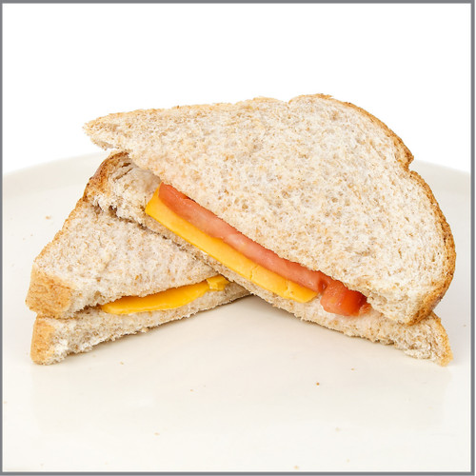
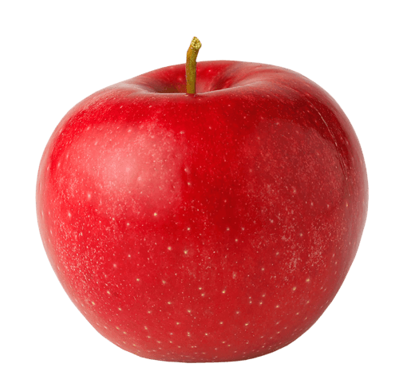
Wa tina
Karakia mō te kai E te atua Whakapainga ēnei kai Hei oranga mō o mātou tinana Whāngaia hoki ō mātou wairua ki te taro o te ora Ko ihu Karaiti tō mātou Ariki Ake ake ake, Amine

Slide 27

Kaupapa Māori Theory
Learning has always been valued and important
Pakiwaitara/pūrākau (oral story telling) method of knowledge transmission
Importance of direct experiences
Knowledge regarded as “taonga” adds to your mana
Responsiblity to the collective, not personal gain
What colonisation has meant for Māori
Transmission of information (Rameka, 2021)
Notes:
Kaupapa = topic programme
As early as in-utero, mothers were passing down knowledge to their pēpi, understandings of ways of being and ancestral significance. This continues as the child grows, with increasing amounts of information based on their understanding and natural tendencies.
Pakiwaitara is oral storytelling, including waiata, to transmit knowledge.
Traditional acquisition of knowledge, outside of being handed down via pakiwaitara, is by doing/experiences. Hands on learning offers first hand experiences to freely explore and discover.
Knowledge is taonga. Taonga adds to mana and is shared with the collective, rather than being for personal gain.
Te Korekore (the spiritual realm of potential being and energy). Cosmic level and interconnectedness of the universe., Te Pō (the realm of becoming, stretching, uncertainty, hesitancy, negotiation and growth). Connections can be made here with early childhood where all of these things take place., Te ao Mārama (The realm of being, realisation, enlightenment and clarification. You can see how this is a cyclical course of being and would happen throughout life, throughout childhood, throughout weeks and even days. None of it is happening in isolation.
Colonisation meant that Māori ways of being were not valued and therefore Māori have struggled to see their culture, language and land rights (taonga) acknowledged and valued. This creates a highly disempowered place in which to live and grow.
Transmission of information; pūrākau (symbolic storytelling – kōwhaiwhai, carvings, etc are examples), whakataukī (proverbs and sayings, help to understand Māori values and ways of being, waiata (songs and chants – very easy ways of both transmitting and learning knowledge), whakapapa (genealogy recitations – for a child to understand where they come from, offers mana and empowerment, a place to stand on the shoulders of their ancestors), whakairo (carvings, traditionally in bone, stone Pounamu and wood – also used as symbolic connection or story telling), haka (dance, think of the all blacks!, traditional use was as part of the ritual of coming together, maybe a chief or manuhiri (visitor) was visiting another tribe), karakia (prayer used to settle), and pakiwaitara (oral story telling).

Slide 28
Exploring Māori Kaupapa Theory
Read page 61 Te Whāriki
Tuakana Teina/ako
Te Whare Tapa Whā – Mason Drurie
Te Wheke – Rose Pere
Notes:
Whiteboard exploration

Slide 29
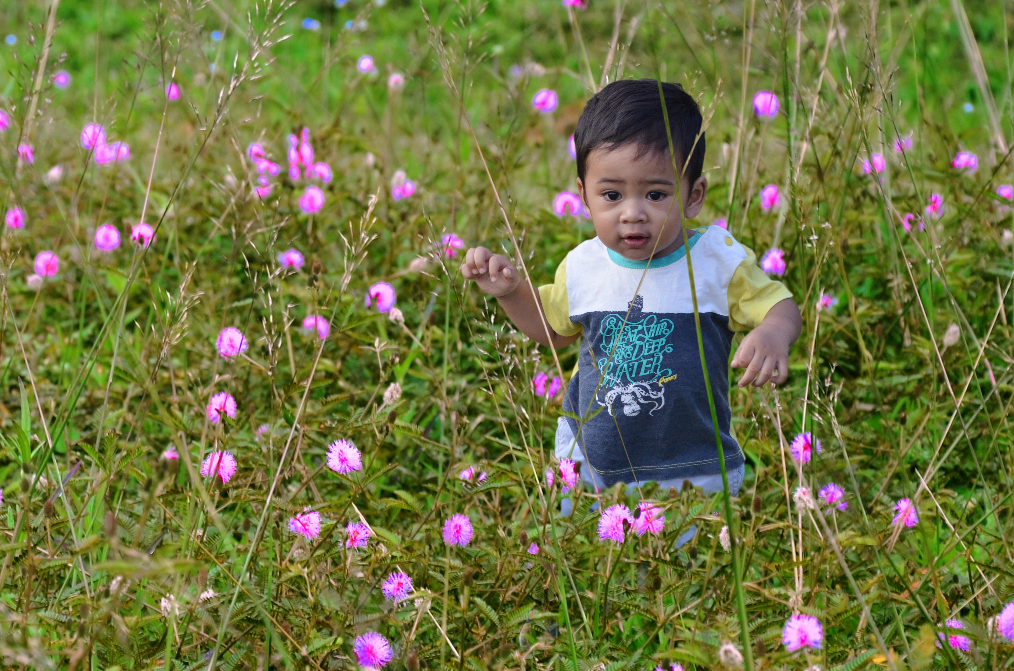
Notes:
In the Western world, it’s common to hear the phrase, child led curriculum, follow the child, the image of the child, etc. There’s a fundamental difference in te ao Māori; we still commit to being led by the child, but there’s an acknowledgement that there’s much more to each child than we can possibly know through observation, and there is a clue in pepeha.
Our mahi with tamariki is not all for the tamariki, as would tend to be the case using a western lens. Each tamaiti has connection to their past and their future. Each time they walk in our doors they are bringing great ancestors with them and the act of teaching and learning is for the ultimate benefit of the entire community.

Slide 30
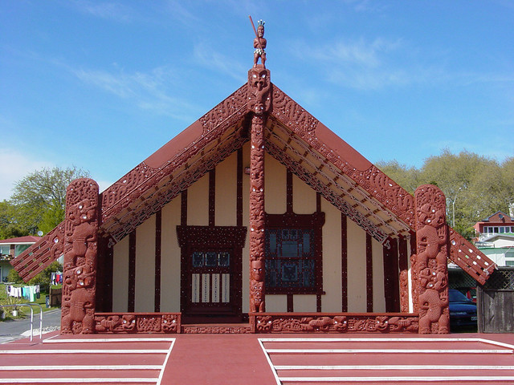
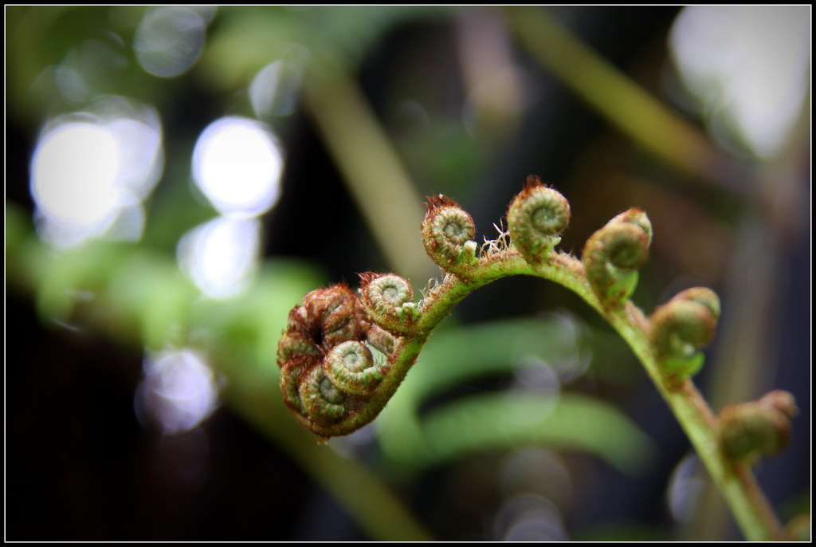
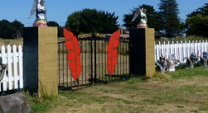
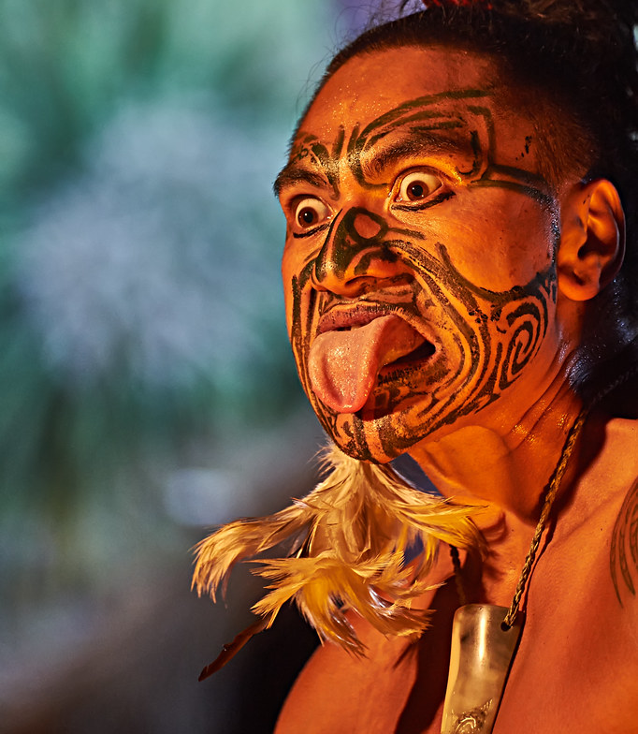
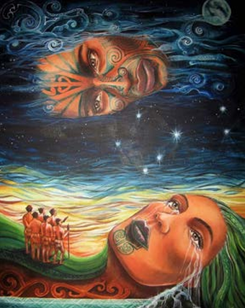

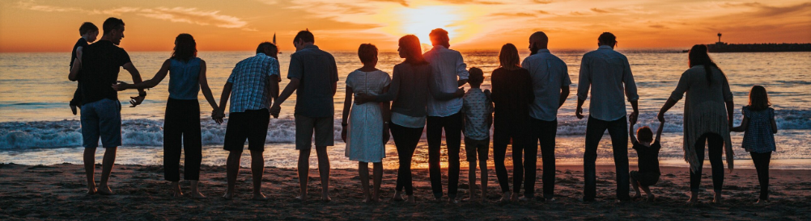
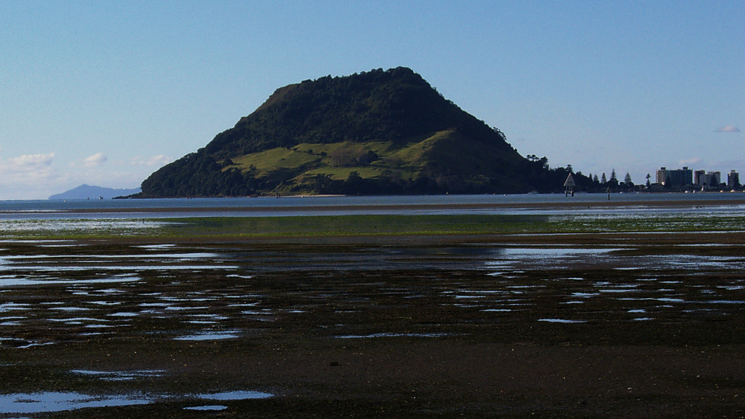
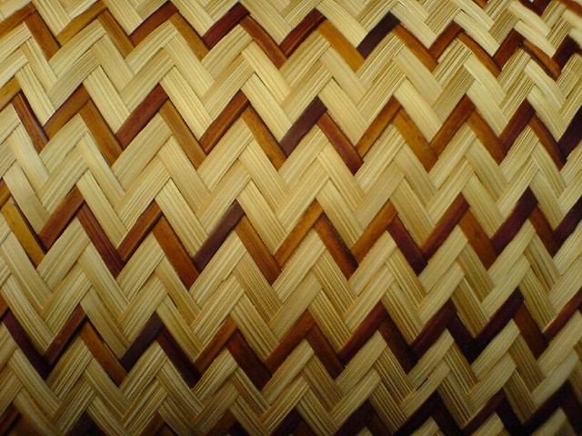
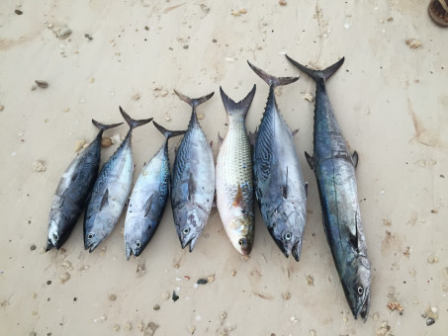
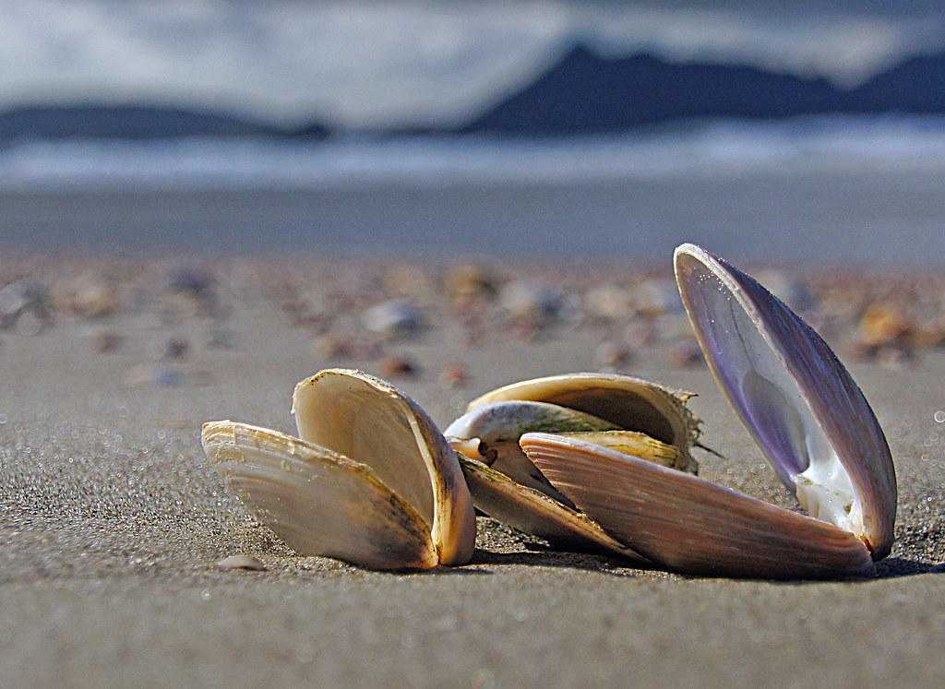
“Ehara taku toa i te toa takitahi, engari he toa takitini”
My strength is not that of an individual but that of the collective
Notes:
Tamariki Māori have spiritual connection to many aspects of the world around them. Mauri is a word that means life force and each human comes with their own mauri. Because it is of a spiritual nature, its strength is built upon by each of these things.
Ngā Atua and their version of creation through the lens of te ao Māori, their relationships with flora and fauna as a sustainable resource.
Their marae, their whānau, hapu and iwi. The urupā. Culture, such as kapa haka, raranga, hāngī, karakia, waita, pakiwaitara, whakatauki – the verbal transmission of information through the generations.
Turangawaewae, their spiritual place to stand – Mauao, Tauranga Moana, etc.
All of this is with them always and similarly, their education is for the benefit of all of this.

Slide 31
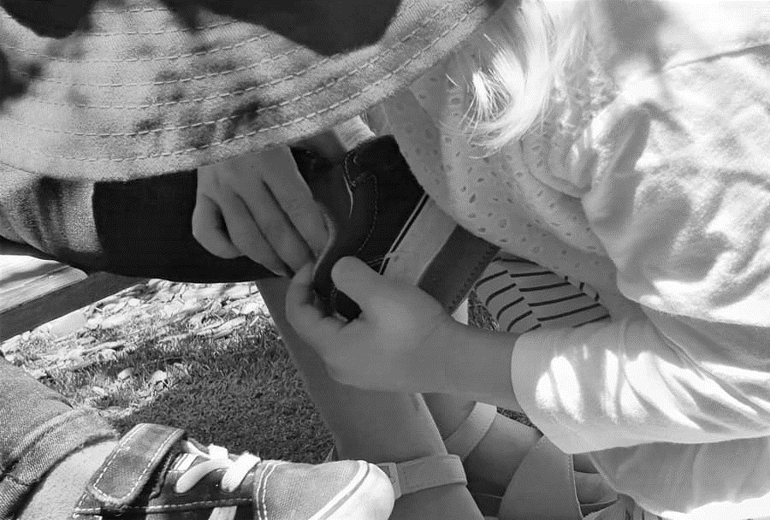
Tuakana/Teina
Integral part of traditional Māori society
Provides for buddy systems
An older or more expert tuakana helps and guides a younger or less experienced teina
(Grazier & Meade, n.d.)
Notes:
Tuakana elder brother or elder sister - same sex
This concept is an aspect of traditional Māori kinsip and communal child-rearing practice that is able to be evidenced in teaching and learning within contemporary ece
Tuākana = elder brothers/sisters same sex
Do they have a tuakana? Or a teina /taina Ko Janet tāku tuakana Ko Janet rāua ko Kim āku tuakana
Tēina younger brothers/sisters same sex
Teina = singular
Ko ___________tōku tuakana/tuākana
Ko ___________ tōku teina/tēina
Think about situations that you have been in and how have you been a participant in a tuakana/teina relationship

Slide 32
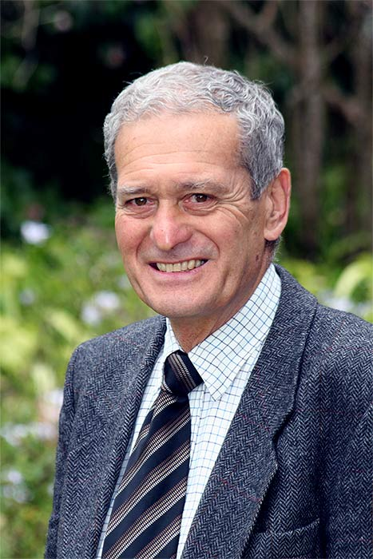
Sir Mason Durie
Whare Tapa Whā is a model commonly used in the health sector, however it stems from Kaupapa Māori and is a great basis for the hauora of tamariki and community.
The model includes four concepts, reflecting each individual’s need to develop holisitically.
(Claiborne & Drewery, 2016)
Notes:
Drewery, W., Claiborne, L. B. (2016). Human development: Family place culture (2nd ed.). McGraw Hill Education, Australia

Slide 33
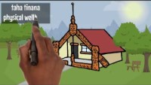
Te Whare tapa whā

Slide 34
Let’s identify our own Te Whare Tapa Whā
Taha Whānau Who are the people, whānau or friends that form your inner circle of support?
Taha Hinengaro What helps to clear your mind? Talking to someone? Being organised so you don’t become overwhelmed?
Taha Wairua What practices (if any) do you use for self care? Spending time with tamariki or friends? Writing in a journal? Yoga? Crystals? Karakia?
Taha Tinana How do you look after yourself physically? A good sleep routine? Limiting social media? Exercise? Eating nourishing food?

Slide 35
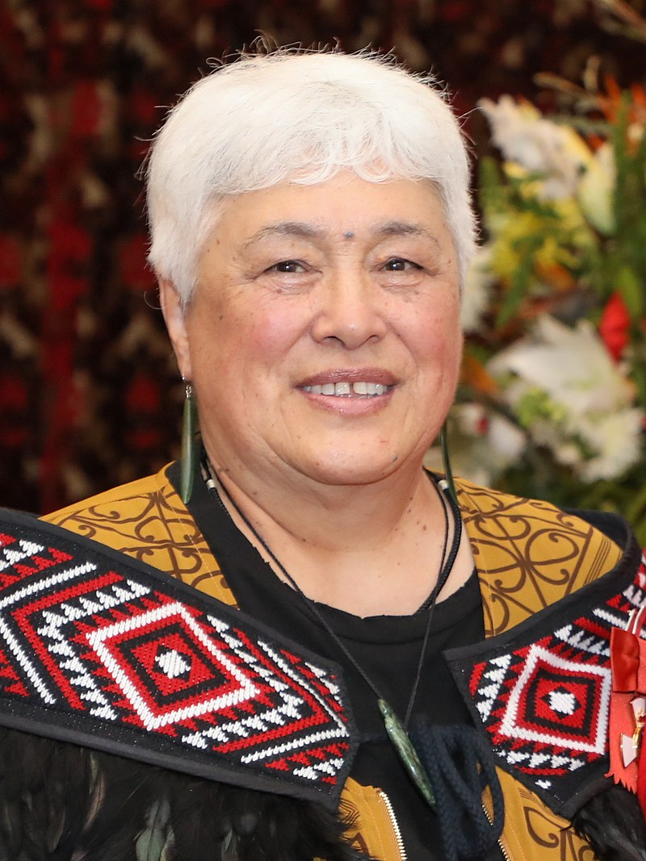
Dr Arapera Royal-Tangaere
For te iwi Māori, the theory of Māori Human Development Learning has been passed on by kaumatua to the generations that follow.
Kaupapa Māori is present in waiata, pakiwaitara and mentioned in many karakia.
It is the Māori way of perceiving the world and the universe and it is embodied in the intricate interrelationships between people and the universe. (Tangaere, 1997)
Notes:
Dr. Arapera Royal-Tangaere is a long time member of Te Kohanga Reo and is currently a manager of the Kohanga Reo National Trust.
She has a wealth of experience, through her own children’s education at Kohanga Reo, Kura Kaupapa Māori, Wharekura and Wānganga.

Slide 36
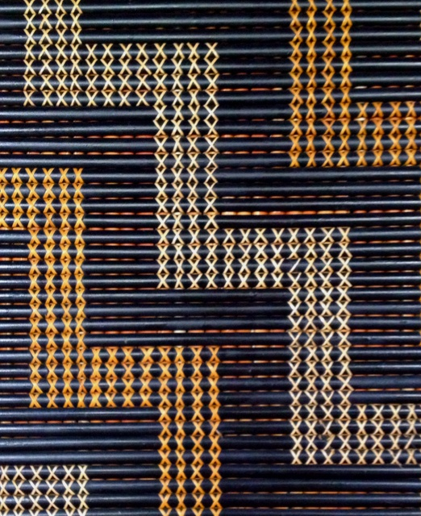
Royal-Tangaere: Poutama
What is a Poutama? What does it traditionally symbolise?
How is it used as an analogy for growth and development?
What responsibility does the tuakana have in learning?
Can you think of any links to Western theory?
How do tamariki learn the values of their culture?

Slide 37
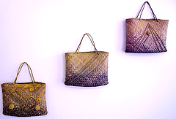
Tāne’s three baskets of knowledge
kete-tuatea
kete-tuauri
kete-aronui
Notes:
This is a short legend of Tāne-nui-a-rangi, I’m going to tell it to you now and then we can consider how it relates to Poutama.
https://www.knowledge-basket.co.nz/about/knowledge-basket-legend/

Slide 38
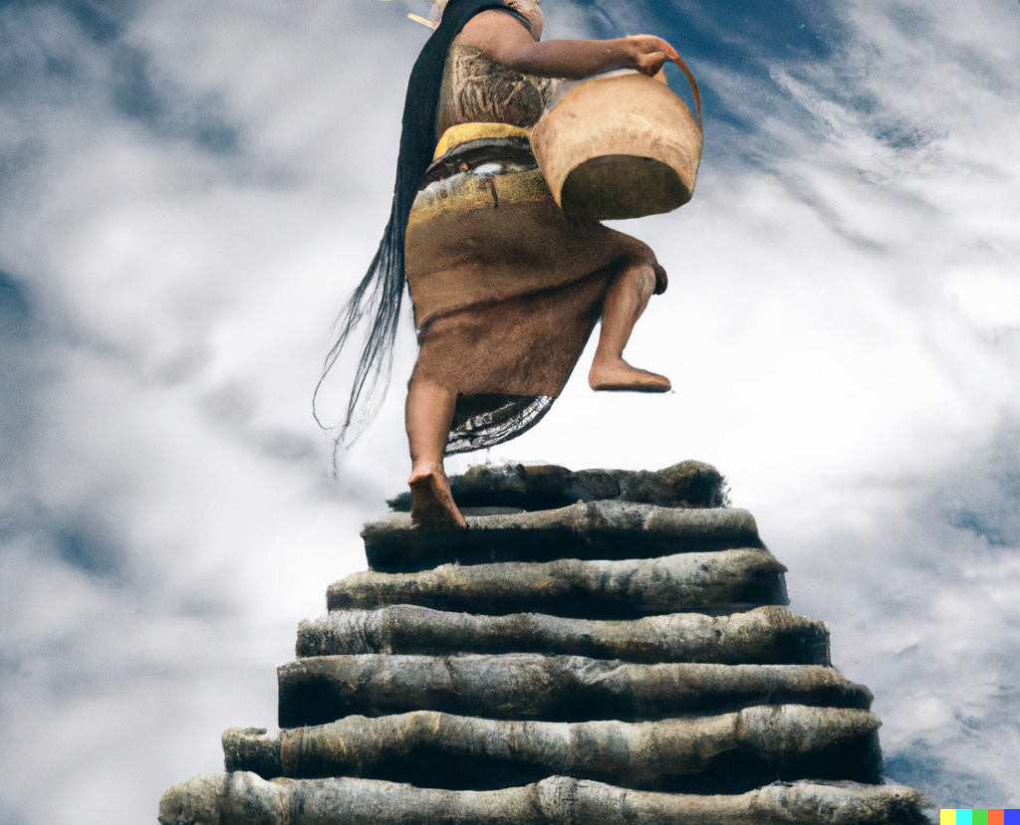
Notes:
To summarise
The Poutama represents the realms to traverse to reach the knowledge baskets.
It acknowledges that there are many different paths to reach that destination.
Another way to think about the multiple staircases is the holistic views of living, learning and support – think back to our spirit, emotions, mind and body mahi.
It shows places of challenge and/or struggle, but that there are also periods of rest (and practicing a skill until it becomes easier to achieve).
It speaks of dispositional values that are of central importance to ultimate success.
It links to Vygotsky’s theory around scaffolding and Zone of Proximal Development (ZPD) which you might have read in the Vygotsky reading linked in Session Two on Moodle. ?Clarify?
The Tuakana-Teina concept, along with learning from the community that you live within also links into Bronfenbrenner’s Ecological Systems Theory.
Can you see how different cultures might have similar understandings and while there will always be subtle differences according to their own priorities, language (more specifically translation) is the key difference.
Out of interest, the reading on Moodle around Poutama has some great links to western theory and to language acquisition theory.

Slide 39
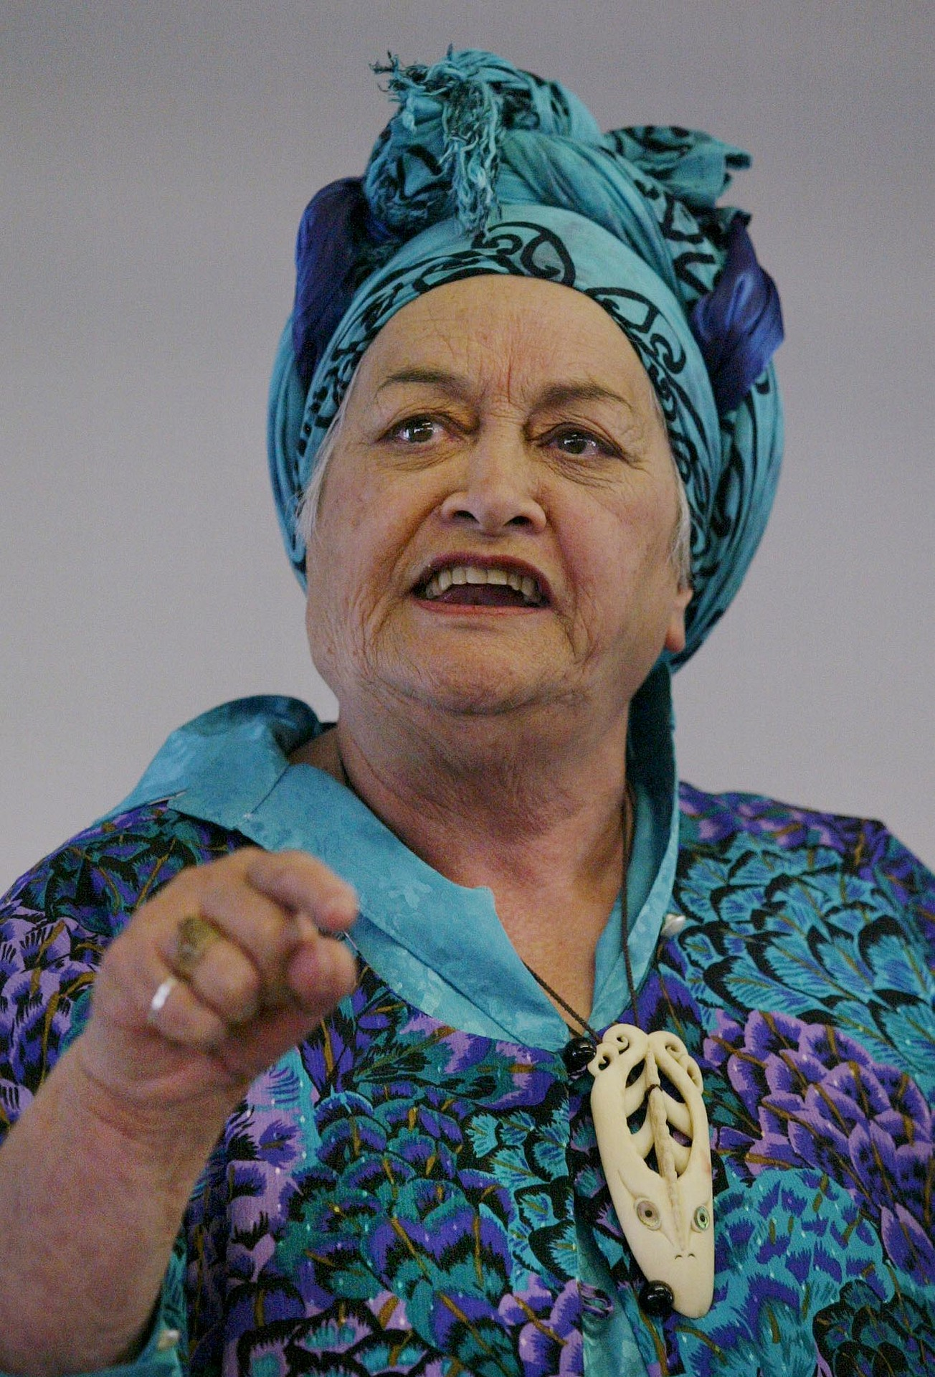
Rangimarie Rose Pere
Also focussing on a health and wellbeing perspective, Rose Pere devised the model Te Wheke based on an octopus (wheke).
Another holistic method of development that acknowledges the inextricable aspects of whānau, wellbeing and health, along with the dimensions that support these relationships.
(Claiborne & Drewery, 2016)
Notes:
Drewery, W., Claiborne, L. B. (2016). Human development: Family place culture (2nd ed.). McGraw Hill Education, Australia

Slide 40

Te Wheke
Te Whānau
The body and head represent the individual whānau unit
Waiora
The “eyes” of the symbolic family unit will reflect total wellbeing
Mana ake
Awareness of heredity from forebears
Hinengaro
Learning that arouses, stimulates and uplifts is important
Wairuatanga
The creator is a powerful influence and the uniqueness of being Māori is sustained through this belief
Whatu manawa
An understanding of emotional development in all ages
Mauri
An appreciation of the Mauri of individuals, whānau and every whānau within a community
Whanaungatanga
The principle of all working to support each other across all generations
Hā a koro mā a kui mā
Links with the heritage passed down by our forebears
Taha Tinana
Specific physical, material, emotional and social needs related to physical survival
Notes:
What are we doing in our practice to be sure we are meeting each of these things?

Slide 41
Karakia whakamutunga – Kia tau
Kia tau ki a tātou katoa
Te atawhai o tō tātou Ariki, a Ihu Karaiti
Me te aroha o te Atua
Me te whiwhingatahitanga
Ki te wairua tapu Ake, ake, ake
Amine

